Slide 1
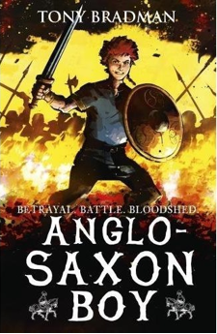
Anglo-Saxon Boy
ONE
Dangerous Times
Fifteen moths earlier – May 1065
https://www.bbc.co.uk/teach/school-radio/history-ks2-anglo-saxons-1066-hastings/zkvxxyc

Slide 2
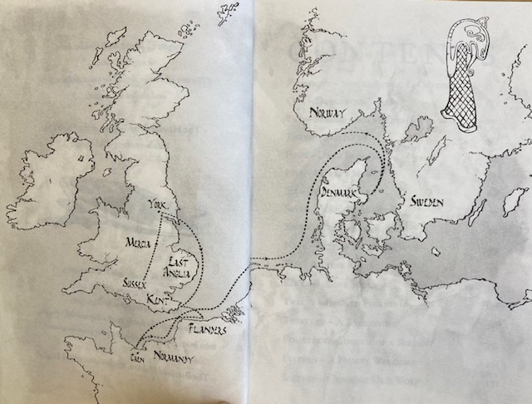
Where did the Anglo-Saxons come from?
Anglo-Saxons came from many places all over Europe including
Denmark, Germany and the Netherlands. They were known at the time as Jutes, Angles and Saxons. They lived in Britain between 410 AD and 1066 AD settling in the country after the Romans left following the collapse of the Roman Empire.

Slide 3
Tricky Vocabulary
palisade
moustache
skirmish
stallion
furrows
swath
Earl
raider

Slide 4
Vocabulary
Can you match up the synonyms.
messenger
soldier
disarray
warrior
forgive
grand
chaos
go-between
crusade
campaign
magnificent
excuse
Notes:
messenger – go-between; soldier – warrior; disarray – chaos; grand – magnificent; excuse – forgive; campaign - crusade

Slide 5
ANSWERS:
messenger
soldier
disarray
warrior
forgive
grand
crusade
chaos
go-between
campaign
magnificent
excuse

Slide 6
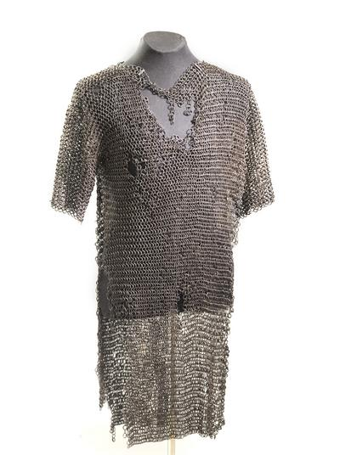
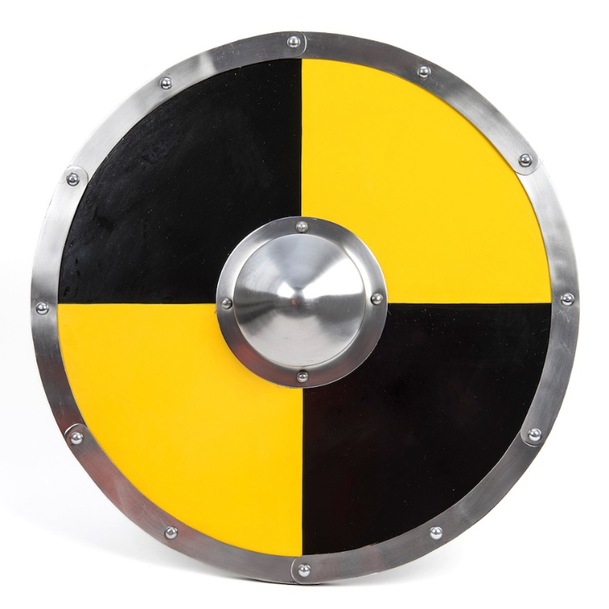
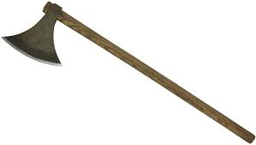
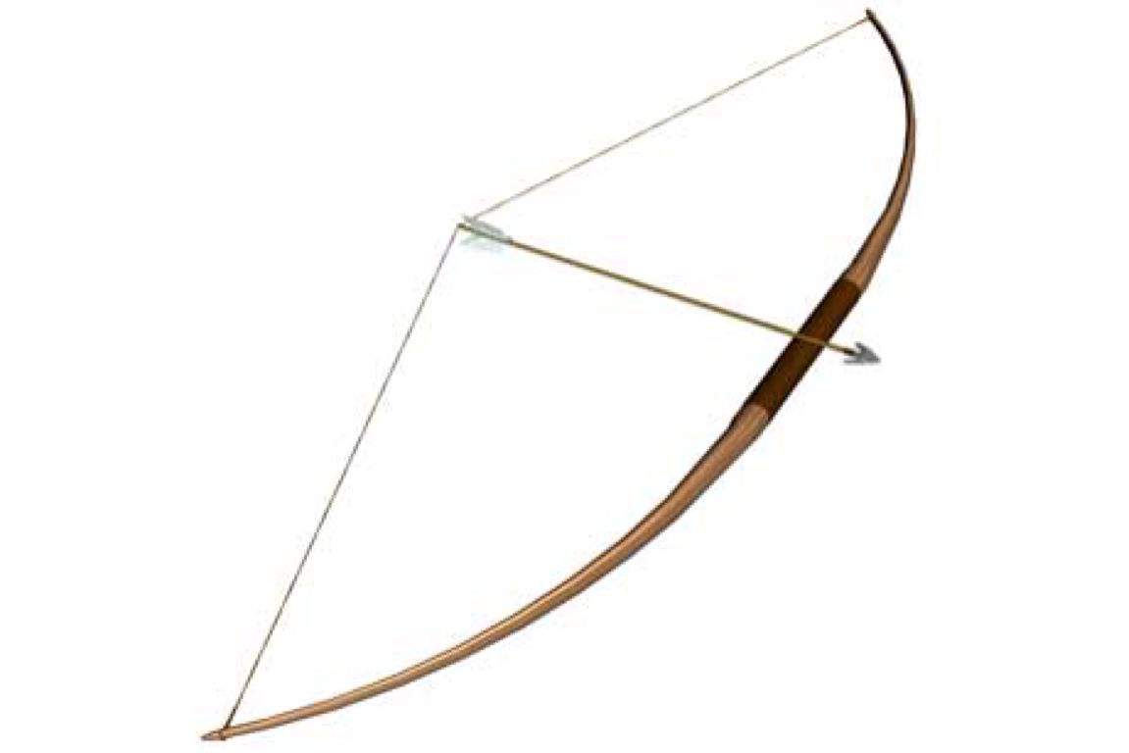
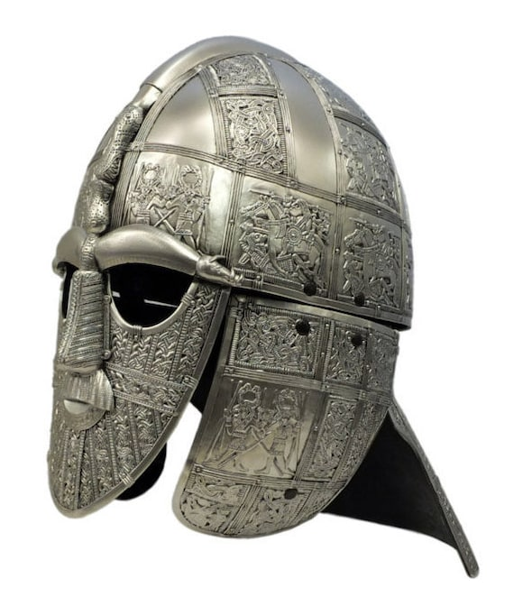
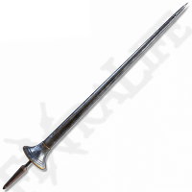
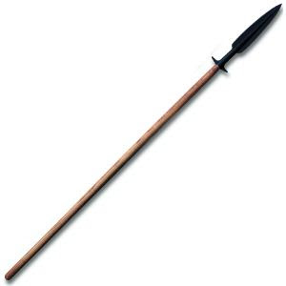
axe
shield
chain mail
bow & arrow
spear
helmet
lance

Slide 7
Vocabulary:
E) What is a messenger? (p.17)
a courier / go-between; someone who delivers a message.
E) Define ‘colliding’. (p.20)
hit by accident when moving.
E) Find and copy a word which means the same as ‘running’. (p.20)
dashing.
E) Define ‘rogue’? (p.25)
a person whose behaviour one disapproves of but who is nonetheless likeable or attractive.
E) What is a ‘skirmish’? (p.22)
a fight.

Slide 8
What does it mean if you ‘don’t suffer fools gladly’? (p.21)
Explain why the author jumps back in time from the prologue in this chapter.

Slide 9
True or False? – One.
Statement
True of False?
Magnus went hunting in the woods.
True
Hakon had a scruffy appearance.
False
Edward was on the throne of England.
True
The Godwin’s were the greatest family in all of England.
True
Magnus had one older sibling.
False

Slide 10
Predict what will happen in the next chapter based on the end of this chapter.

Slide 11
What colour was Hakon’s shirt? (p.)
What made it clear that Hakon was a warrior? (p.)
What did people call his mother? (p.)
What was Magnus’ father famous for? (p.)
What was his dad called? (p.)
How did Magnus know he had grown? (p.)
Find and copy the names of two buildings that surrounded the farm. (p.)
Where did Magnus’s father own land? (p.23)

Slide 12
What time of the day was it? How do you know? (p.)
Why do you think they have a ‘watchtower’ at the farm? (p.)
Find and copy a phrase which suggests it was a scary time to be alive. (p.)
Why was it considered bad to see a messenger? (p.)
Find and copy a sentence which shows Magnus thought his dad looked like royalty. (p.)

Slide 13
What does it mean if you ‘don’t suffer fools gladly’? (p.21)
What made it clear that Hakon was a warrior? (p.18)
What was Magnus’ father famous for? (p.19)
Find and copy the names of two buildings that surrounded the farm. (p.22)
Where did Magnus’s father own land? (p.23)
At the beginning of the chapter, what time of the day was it? How do you know? (p.17)
Why was it considered bad to see a messenger? (p.19)

Slide 14
Summarise this chapter in no more than two sentences.

